Slide 1
UNIT1 : O1
Understand how safe working practices are applied in a business environment

Slide 2
Your Task: To Get A Pass
Hounslow Manor School has a lot of computers. These computers are used by students and teachers. You need to give some examples of safe working practices when using ICT in the school. Your explanations should include potential dangers/risks that each measure is designed to address.
Explanations:
Measures to protect health,
Measures to protect physical safety,
Measures to protect electronic files from loss,
Measures to protect electronic files from unauthorised access,
Measures to protect electronic files from modification

Slide 3
How to get a PASS, MERIT or DISTINCTION
Use text, and appropriate illustrated images from the internet
Describe at least one measure in each category,
The examples used might be images showing safe or dangerous working practices or examples drawn from your own experience of using ICT at Hounslow Manor, or at home or at a computer centre
Explanation example 1:
PASS: To Pass, explain the need for the screen to be at the right height.
MERIT: To get a MERIT, explain the need for the screen to be at the a specific height.
DISTICTION: To get a DISTINCTION, explain the need for the screen to be at the a specific height, distance and angle of the screen.
Explanation example 2:
PASS: To Pass, describe the need to back up files.
DISTICTION: To get a DISTINCTION, describe the need to back up files, how often the files should be backed up(frequency of backup), the type of storage device to use and where the storage device should be stored.
To avoid what potential danger/risk? Or Reasons for measure :
Examples::
• complying with health and safety legislation
• ensuring safety of staff, equipment and data
Please also discuss:
• specific reasons for different measures, matching the measure with the risk it is intended to protect from.

Slide 4
Measure to protect the health of staff and students, when using ICT at Hounslow Manor School
Positioning of equipment.
To avoid what potential danger/risk? Or Reasons for measure :
Explanation and appropriate images:

Slide 5
Measure to protect the health of staff and students, when using ICT at Hounslow Manor School
Posture.
To avoid what potential danger/risk? Or Reasons for measure :
Explanation and appropriate images:

Slide 6
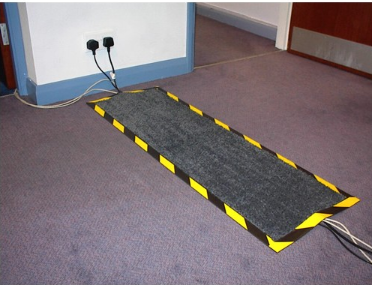
Measure to protect the physical safety of staff and students, when using ICT at Hounslow Manor School
Trip hazards eg trailing cables.
To avoid what potential danger/risk? Or Reasons for measure :
Risk of people tripping or falling over.
Explanation and appropriate images:

Slide 7
Measure to protect the physical safety of staff and students, when using ICT at Hounslow Manor School
Electrical safety, - no water by machines.
To avoid what potential danger/risk? Or Reasons for measure :
Explanation and appropriate images:

Slide 8
Measure to protect the physical safety of staff and students, when using ICT at Hounslow Manor School
Electrical safety, - not overloading sockets.
To avoid what potential danger/risk? Or Reasons for measure :
Explanation and appropriate images:

Slide 9
Measure to protect the physical safety of staff and students, when using ICT at Hounslow Manor School
Safely positioning equipment to avoid falls.
To avoid what potential danger/risk? Or Reasons for measure :
Explanation and appropriate images:

Slide 10
Measure to protect electronic files from loss when using ICT at Hounslow Manor School
Organising files – into a folder structure.
To avoid what potential danger/risk? Or Reasons for measure :
Explanation and appropriate images:

Slide 11
Measure to protect electronic files from loss when using ICT at Hounslow Manor School
Organising files – into meaningful file names and folder names.
To avoid what potential danger/risk? Or Reasons for measure :
Explanation and appropriate images:

Slide 12
Measure to protect electronic files from unauthorised access, when using ICT at Hounslow Manor School
Setting a password to open a file.
To avoid what potential danger/risk? Or Reasons for measure :
Explanation and appropriate images:

